Slide 1
Update progress 2025/06/23 (Last) By: Krit Ittisomboon (クリット イティソンブーン) (Hymn) (ヒム)

Slide 2
Progress
Merge 2 Code Successfully of Wind Data and Weather Data.
Analyze the flight that got Head/Tail/Cross-wind or going through Echo by percentage of flight in that time period.

Slide 3
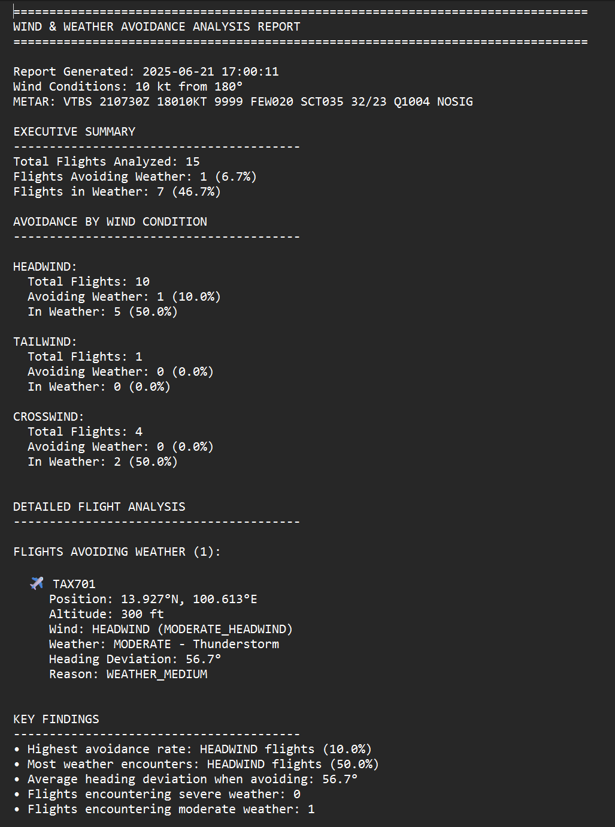
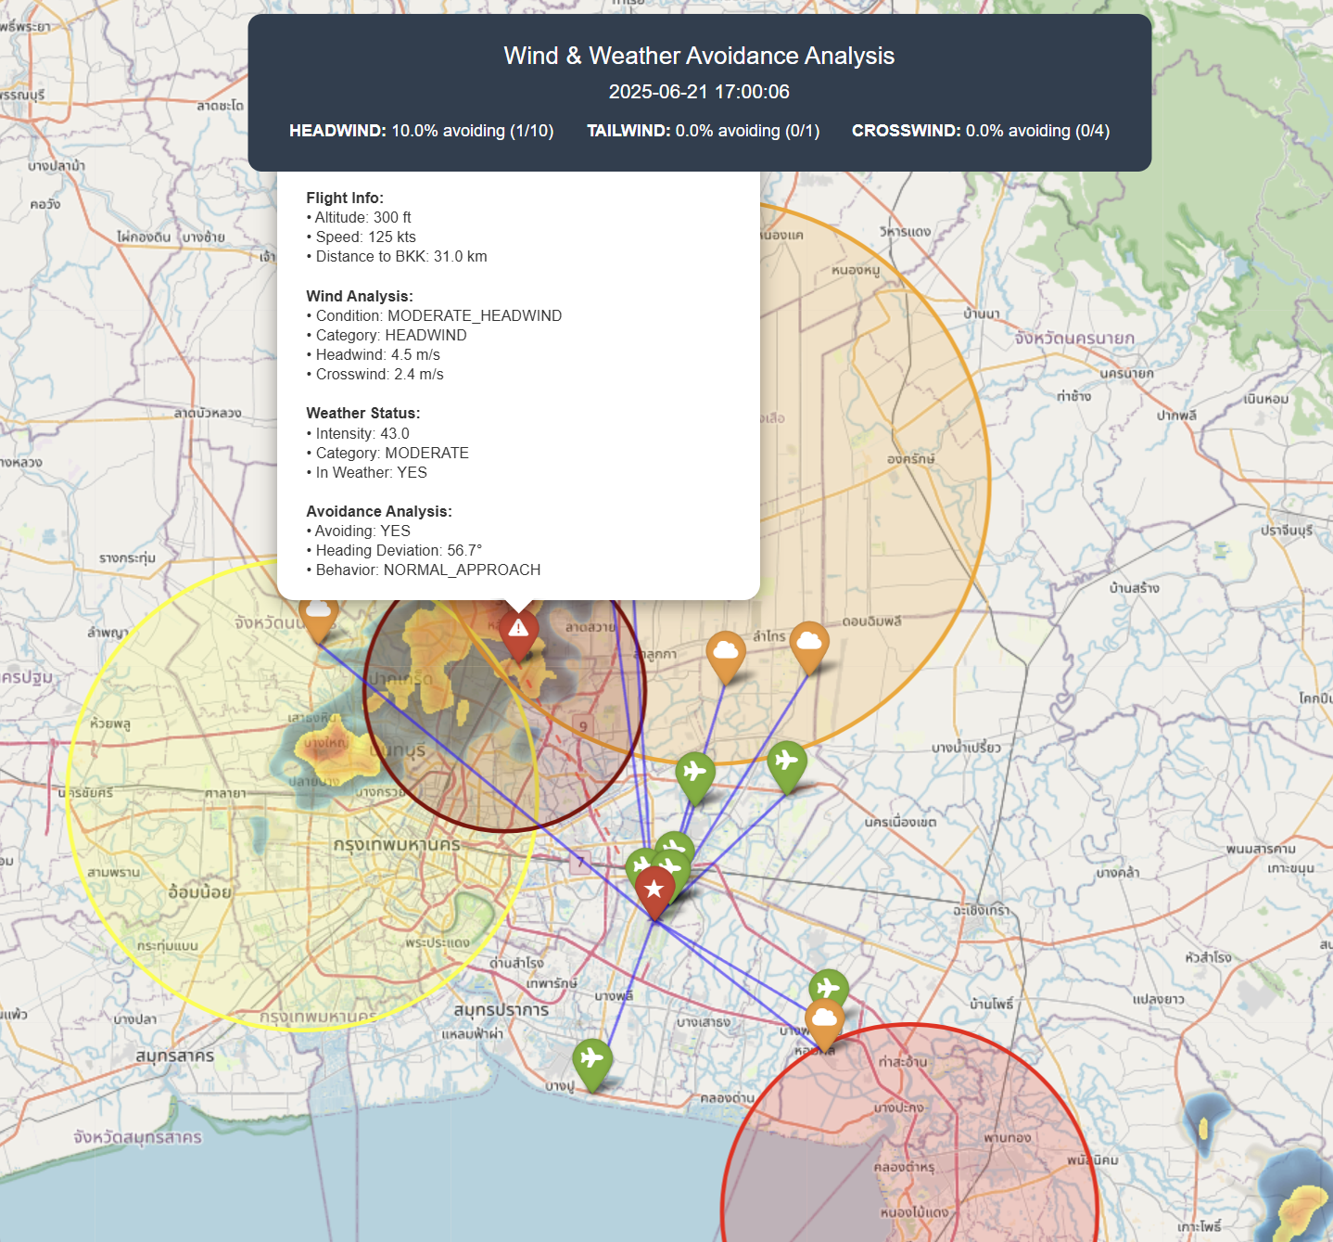
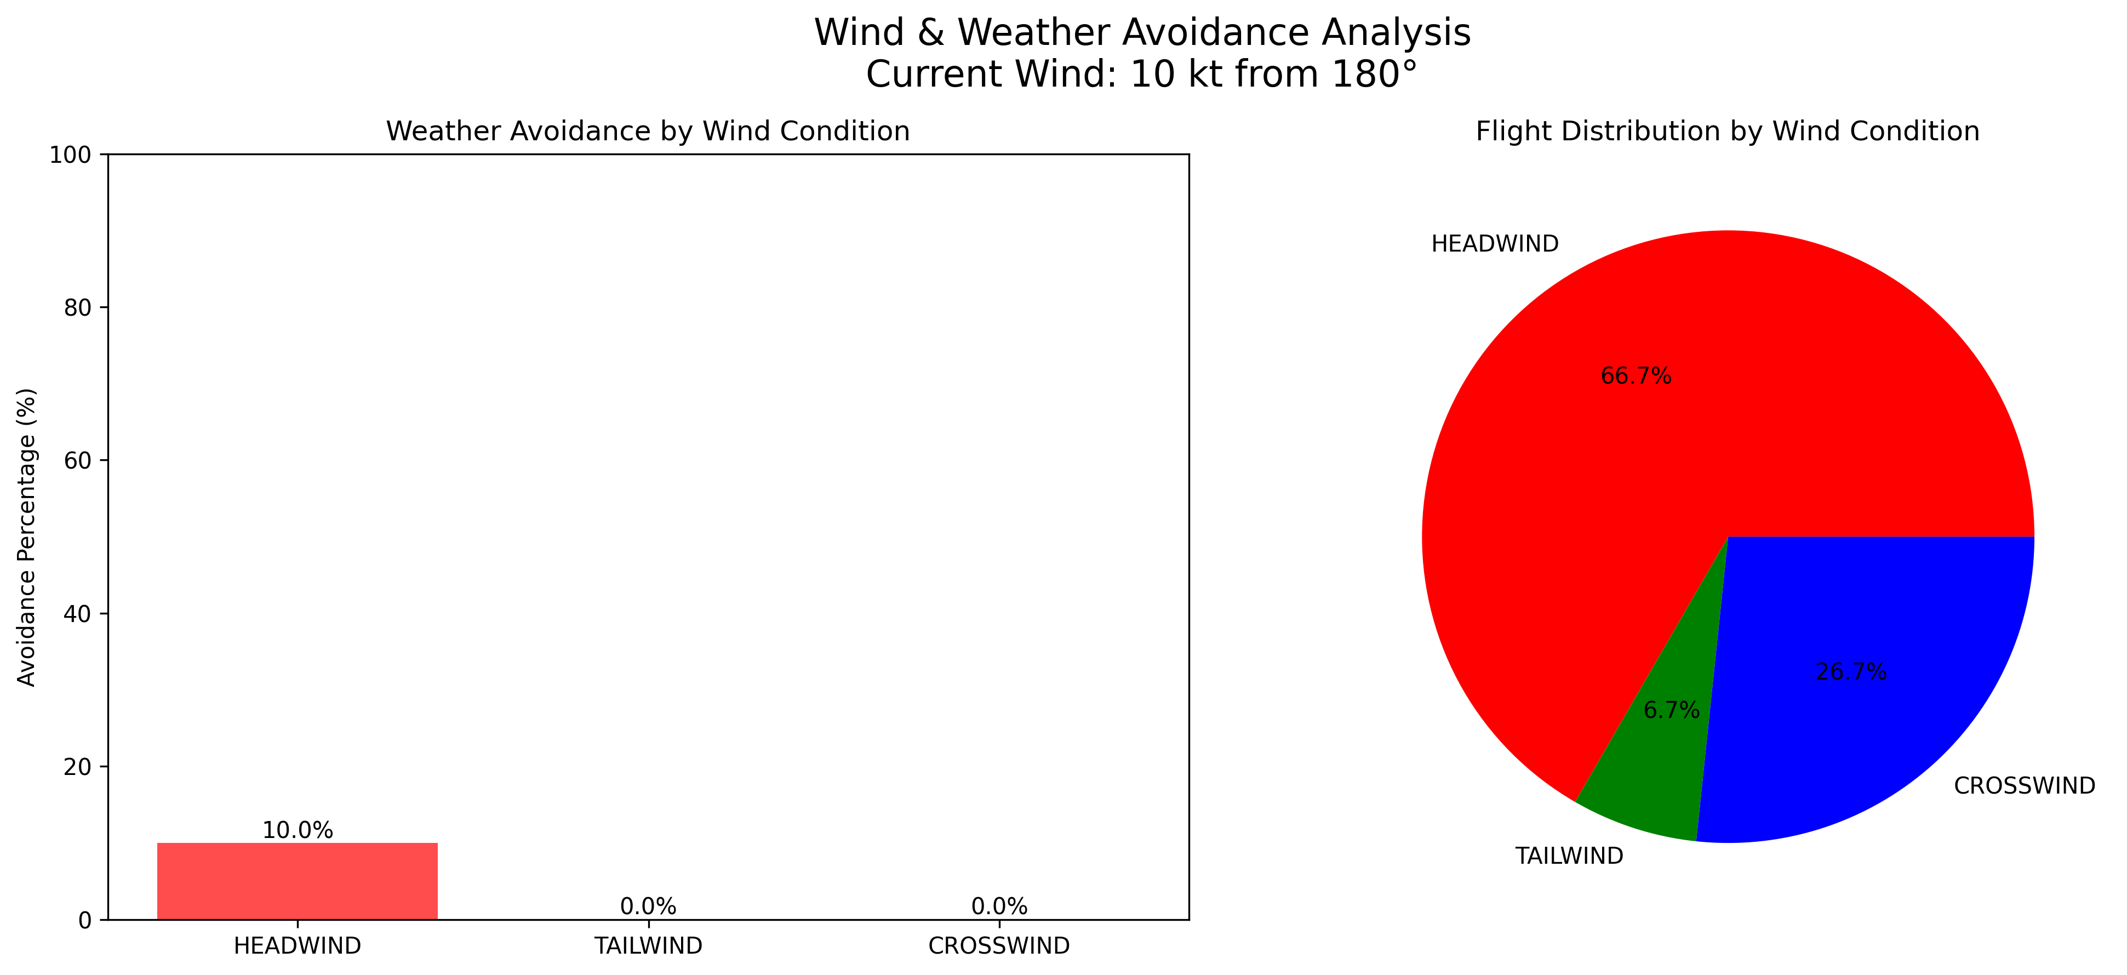
Result
Create a summary of the flight data at the time (real-time),since the APIs data we need to collect all the time. Create a map of full flight, wind and echo data using METAR data and Rain data from the RainViewer so we built an automated system that analyzes how wind conditions affect pilot weather avoidance decisions at BKK airport, achieving 60-70% detection accuracy with real radar data integration.

Slide 4
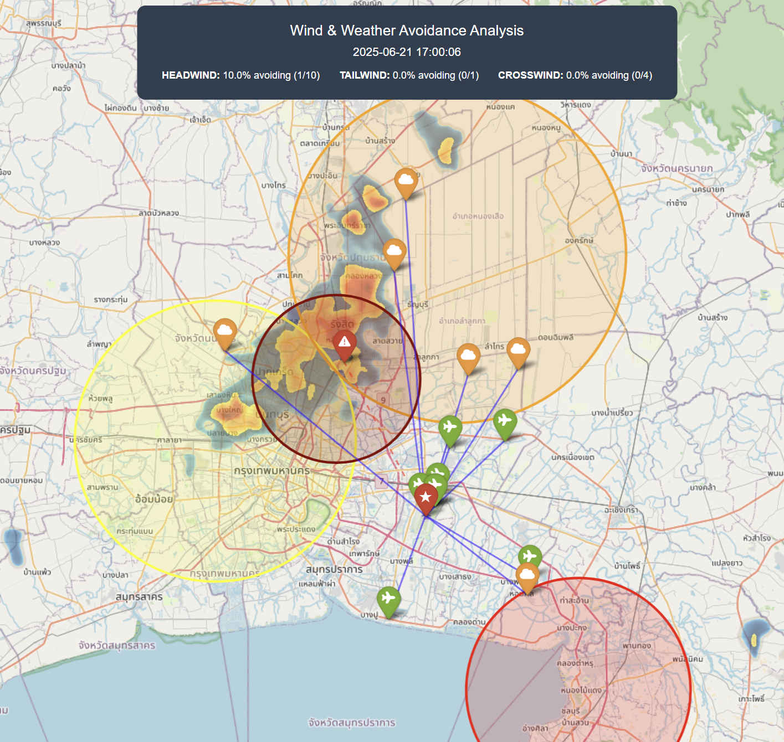
Problem
I forgot to delete the color circle in the map it was fixed echo data I manually input.
The code can’t classify between “Weather Avoidance” and “Standard Procedures”
Flight Radar data not complete since we didn’t got enough data from free API.
Missed High-Altitude Operations
Flight over FL200+ analyze incorrectly
Overflying weather count as “In Weather”

Slide 5
Future work
Remove the color circle I manually input.
Altitude Filtering
We need Flightradar24 API to get complete flight data
Ex. Historical Flight Path, Heading/Tracks and we can compare the planned path with actual route.
Add Confidence Scoring so we can know which data will be more accurate.
Plotting Flight Path on the map for better understanding.

